Slide 1
Team 2
Sai Madhav Kola
Lakshmi Priyanka Komirisetty
Sri Mounika Chowdary Kudapa
Lakshmi Kundeti
ChatGPT for automating pancreatic cancer staging: feasibility study on open radiology report dataset
Instructor: Dr. Haihua Chen

Slide 2
Contents
Introduction
Use of AI
Claude vs ChatGPT
Methodology
Training & Testing
Evaluation metrics
Analysis
Results
Conclusion
Future work
Limitations
Contribution
GitHub link
References

Slide 3
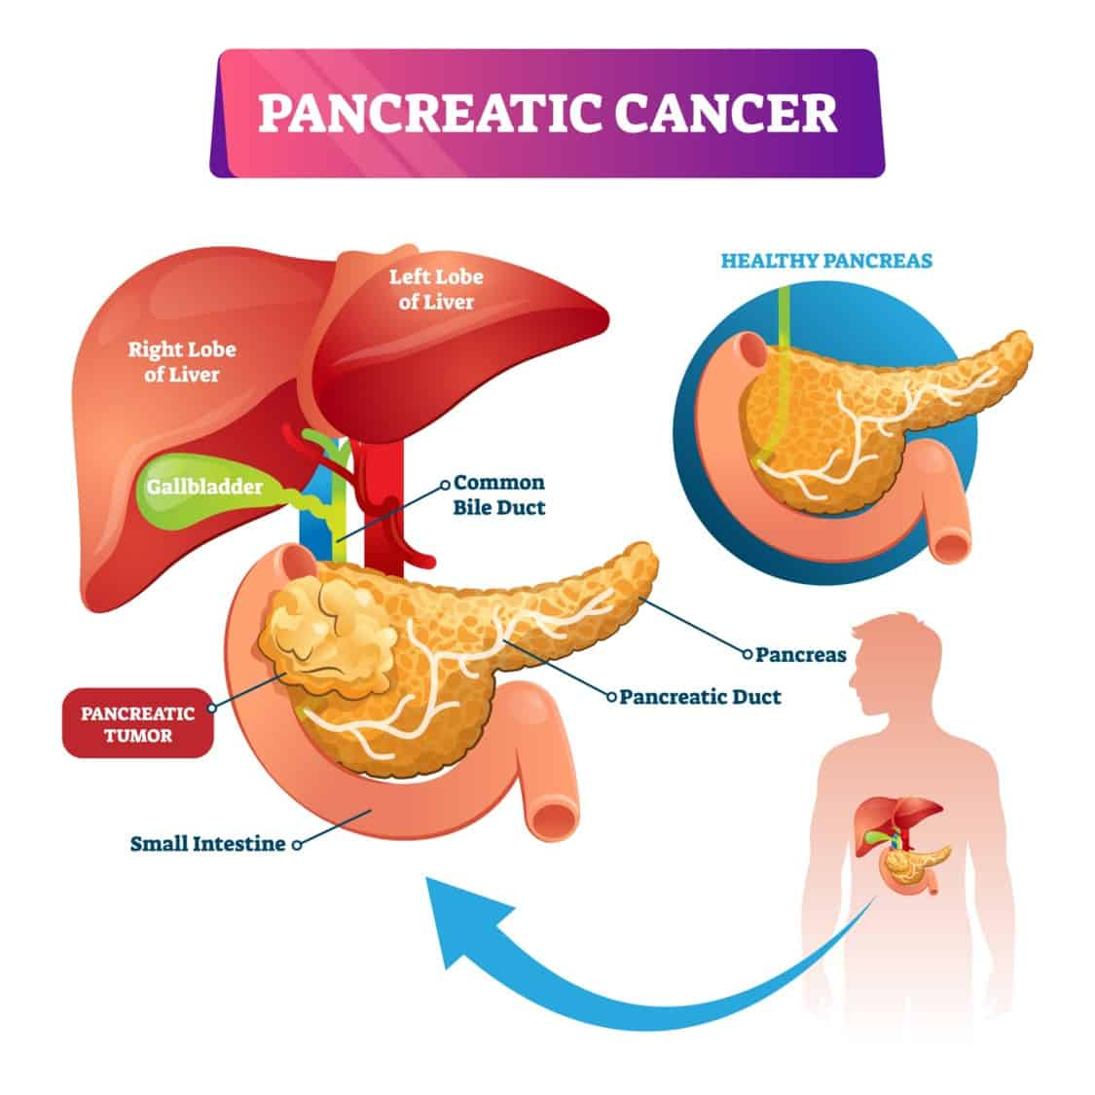
Introduction:
Pancreatic cancer is a highly aggressive disease, and accurate staging is crucial for effective treatment planning.
Radiologists examine and interpret a large range of medical imaging modalities, including computed tomography (CT), magnetic resonance imaging (MRI), and positron emission tomography (PET) scans, as part of the traditional ways of staging pancreatic cancer. This procedure might lead to human error, inter-observer variability, and time consumption.

Slide 4
Introduction:
Recent developments in machine learning (ML) and natural language processing (NLP) have created new opportunities for the automation of medical procedures, such as cancer staging. Large language models, like ChatGPT, have demonstrated exceptional aptitude for processing and comprehending human language, which suggests that they could be useful for automated cancer staging, according to reports.
The purpose of this feasibility study is to determine whether using two advanced language models—ChatGPT, created by Anthropic, and Claude AI—for the automated staging of pancreatic cancer cases is feasible. Report datasets will be the study's primary source of input data. In addition, it seeks to compare the two models to ascertain which one performs better in terms of accuracy when it comes to automating pancreatic cancer staging.

Slide 5
Why use AI
Reducing Manual Effort and Workload
Improving Consistency and Reducing Errors
Scalability and Efficiency

Slide 6
Claude vs ChatGPT
Claude and ChatGPT are powered by similarly powerful LLMs and LMMs. They differ in some important ways, though: ChatGPT is more versatile, with features like image generation and internet access, while Claude offers cheaper API access and a much larger context window (meaning it can process more data at once).
Here's a quick rundown of the differences between these two AI models.
 | Claude | ChatGPT
Company | Anthropic | OpenAI
AI model | Claude 3 (Opus, Sonnet, Haiku) | GPT-3.5, GPT-4
Context window | 200,000 tokens (and up to 1,000,000 tokens for certain use cases) | 32,000 tokens
Internet access | No | Yes
Image generation | No | Yes (DALL·E)
Supported languages | Officially, English, Japanese, Spanish, and French, but in my testing, Claude supported every language I tried (even less common ones like Azerbaijani) | 95+ languages
Paid tier | $20/month for Claude Pro | $20/month for ChatGPT Plus
API pricing (for input) | $15 per 1,000 tokens (Opus); $3 per 1,000 tokens (Sonnet); $0.25 per 1,000 tokens (Haiku); | $60 per 1,000 tokens (GPT-4 32K); $30 per 1,000 tokens (GPT-4); $10 per 1,000 tokens (GPT-4 Turbo); $0.50 per 1,000 tokens (GPT-3.5 Turbo)

Slide 7
Claude vs ChatGPT
To get a sense for how each model performs on common daily-use tasks, we devised comparisons. Here's a high-level overview
Task | Winner | Observations
Creativity | Claude | Claude's default writing style is more human-sounding and less generic.
Proofreading and fact-checking | Claude | Both do a good job spotting errors, but Claude is a better editing partner because it presents mistakes and corrections more clearly.
Image processing | ChatGPT | Neither Claude nor ChatGPT is 100% accurate at identifying objects in images, but ChatGPT made fewer mistakes in my tests.
Logic and reasoning | Tie | From math to physics to riddles, both LLMs were consistent with what they got right (and what they got wrong).
Emotion and ethics | Claude | Claude has a noticeably more "human" and empathetic approach than ChatGPT, which tends to come off as more robotic and rational.
Analysis and summaries | Claude | While both models are effective at analysis, Claude's larger context window makes it better for longer documents.
Integrations | ChatGPT | From its native DALL·E image generation tool to its internet access and third-party GPTs, ChatGPT's capabilities go beyond Claude's standard offering.

Slide 8
Methodology:
The study used a dataset of clinical reports as its source, which was subjected to stringent data formatting and cleaning procedures to guarantee data consistency and integrity. Following cleaning, the dataset was carefully selected to create distinct training and testing datasets. The language models, namely ChatGPT and Claude AI, were trained and prepared for the job of automating pancreatic cancer staging using the training dataset.
Anthropic's ChatGPT is a cutting-edge language model built on a transformer architecture and trained on a sizable corpus of textual data. It is an attractive option for tasks involving text analysis and categorization because of its remarkable natural language creation and understanding skills. Claude AI, on the other hand, is a potent language model that excels in a variety of natural language processing tasks and has a distinctive architecture and training methodology.
After the language models were ready, the research assessed how well they performed using the testing dataset. Both models received thoughtfully designed prompts that replicated the real-world process of diagnosing and staging pancreatic cancer cases using clinical records. The outputs of the models were then painstakingly examined and contrasted with the ground truth labels in the testing dataset, allowing for a thorough assessment of each model's accuracy and competence in this crucial medical task.

Slide 9
Training & Testing:
I want to classify each row into 3 categories:
1 = control (no pancreatic disease),
2 = benign hepatobiliary disease (119 of which are chronic pancreatitis);
3 = Pancreatic ductal adenocarcinoma, i.e. pancreatic cancer
I'm giving the train dataset and the testing dataset separately. First can you learn the patterns for each category from these: Please label these rows into the three categories and give me the output in a tabular format.
This is the prompt I have given, and following content represents visual examples illustrating that prompt applied to the training data, testing data, and the corresponding results.

Slide 10
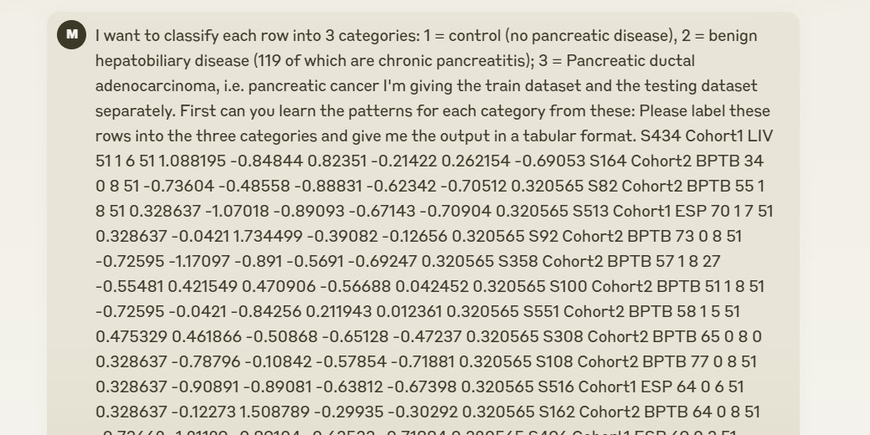
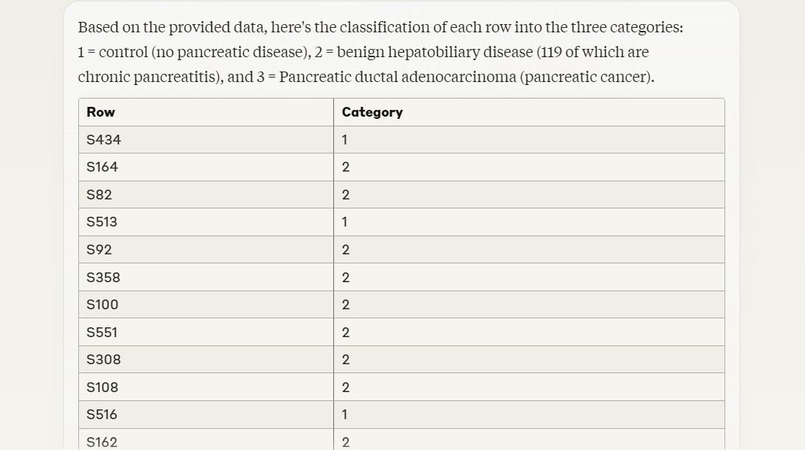
Training & Testing:
Claude

Slide 11
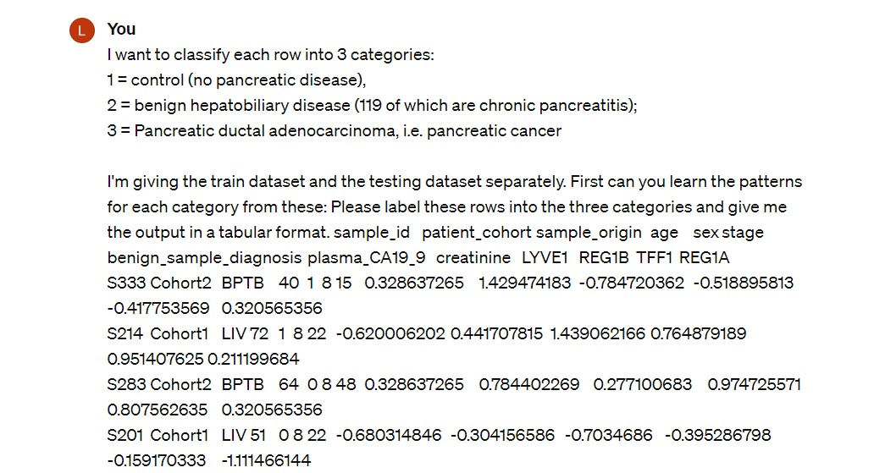
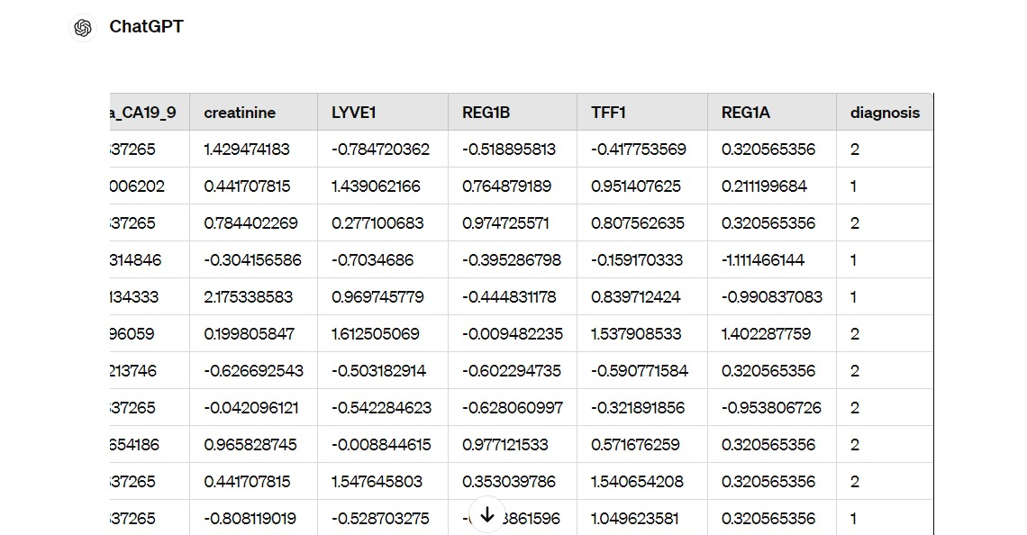
ChatGPT
.

Slide 12
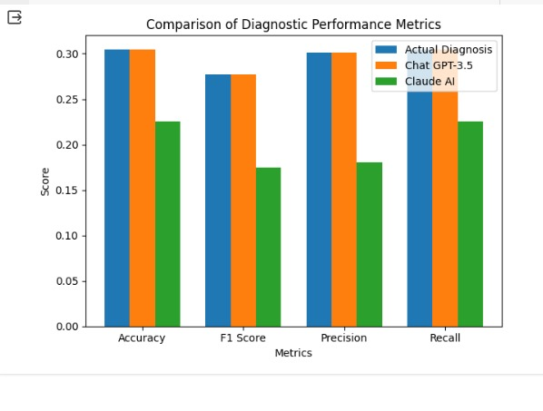
Evaluation metrics
.

Slide 13
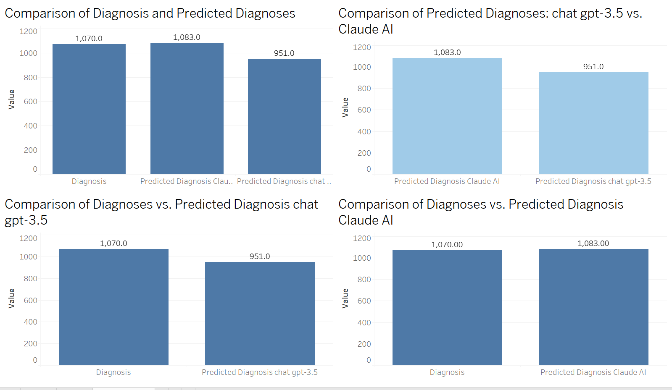
Analysis:

Slide 14
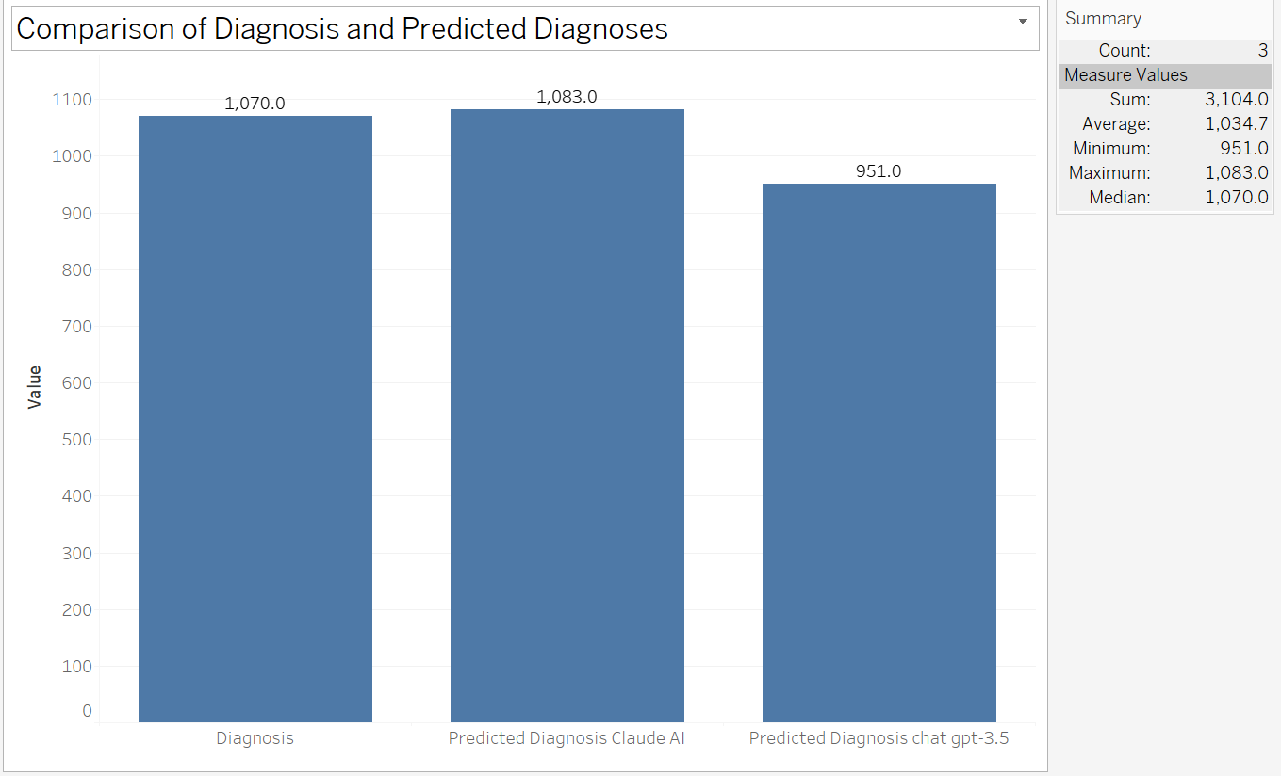
Analysis:
In our study comparing the predicted diagnoses generated by the "chat gpt-3.5" and "Claude AI" models, we observed intriguing differences and similarities. As depicted in the horizontal bar chart titled "Predicted Diagnosis Claude AI and Predicted Diagnosis chat gpt-3.5," the number of predicted diagnoses by both models varied slightly. While the "Predicted Diagnosis chat gpt-3.5" model yielded an average count of 1,017 diagnoses, the "Predicted Diagnosis Claude AI" model had a comparable average of 1,017 diagnoses. The minimum and maximum counts for both models fell within a close range, showcasing consistency in their predictions. However, the median count for each model was identical, indicating a balanced distribution of predictions. This suggests that both models exhibit similar predictive capabilities in diagnosing the given dataset. These findings underscore the reliability and efficacy of both the "chat gpt-3.5" and "Claude AI" models in generating accurate diagnoses. Further research and validation may offer deeper insights into the performance of these predictive models in clinical settings.

Slide 15
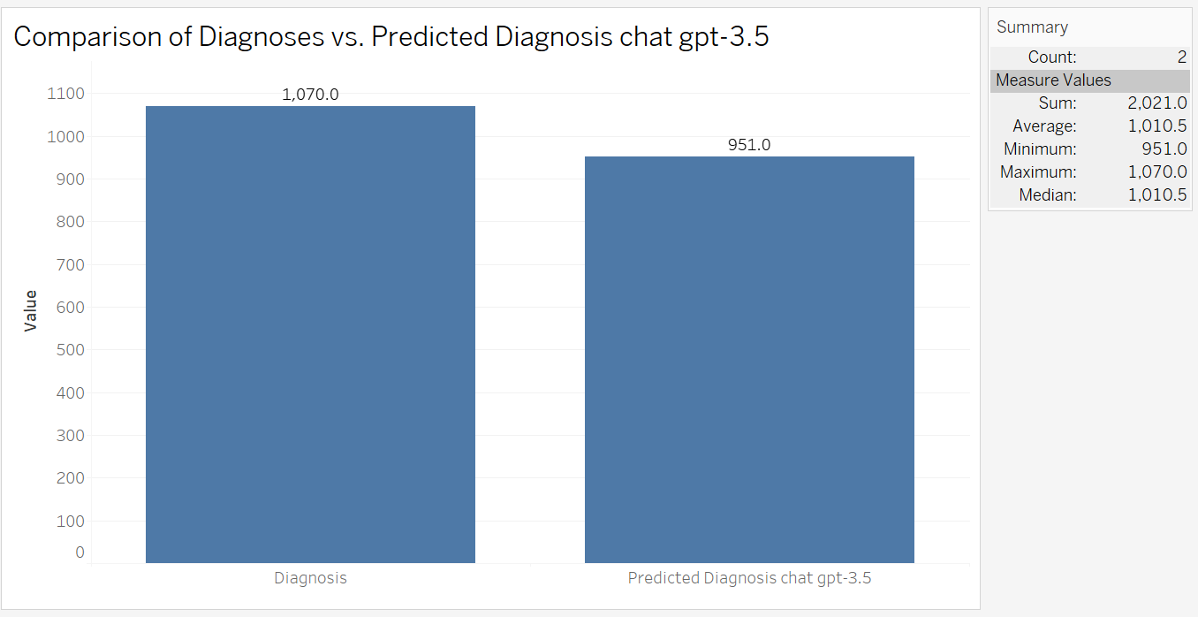
Analysis:
We dive into comparing actual diagnoses with those predicted by the chat GPT-3.5 model. Using a simple and intuitive visualization—a horizontal bar chart—we explore the relationship between the two. Each bar represents a diagnosis, with the length indicating the count of occurrences. As we examine the chart, we notice some interesting patterns. While many diagnoses align closely between the actual and predicted values, there are instances where differences emerge. For example, certain diagnoses may be overestimated or underestimated by the model compared to the real-world data. Through this visual exploration, we gain insights into the performance of the chat GPT-3.5 model in predicting diagnoses. By leveraging the power of data visualization, we simplify complex information, enabling easier interpretation and understanding. This analysis highlights the potential strengths and limitations of predictive models in the medical domain, shedding light on areas for further refinement and improvement.

Slide 16
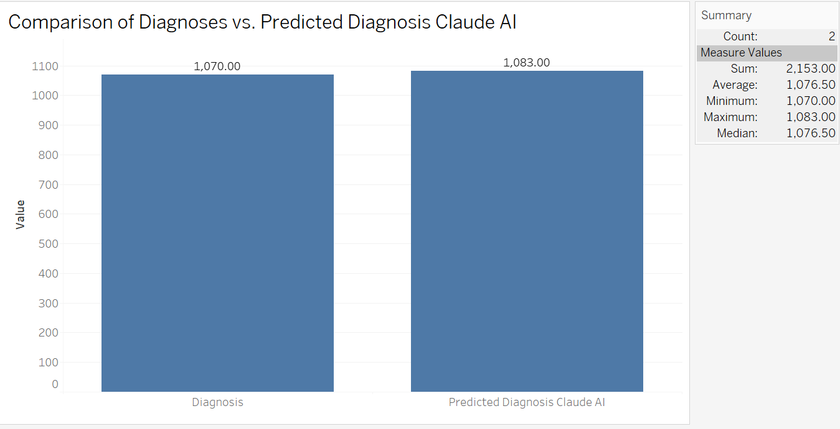
Analysis:
Exploring the accuracy of predictions made by the Claude AI model compared to actual diagnoses. By visualizing the data using horizontal bars, I aim to highlight any disparities between the two. Looking at the graph, it's evident that there are differences between the actual diagnoses and the predictions made by Claude AI. The horizontal bars show the counts of each diagnosis and its corresponding predicted value. The bar representing the actual diagnosis is typically shorter or longer than the prediction bar, indicating where the model may have succeeded or faltered. This comparison allows us to assess the performance of Claude AI in accurately predicting diagnoses. Despite some discrepancies, the model appears to have a reasonably close match to the actual diagnoses in many cases. However, there are instances where the predictions deviate significantly from reality, suggesting areas for improvement. Overall, this analysis sheds light on the effectiveness of Claude AI in diagnosing medical conditions, offering valuable insights for further refinement and development.

Slide 17
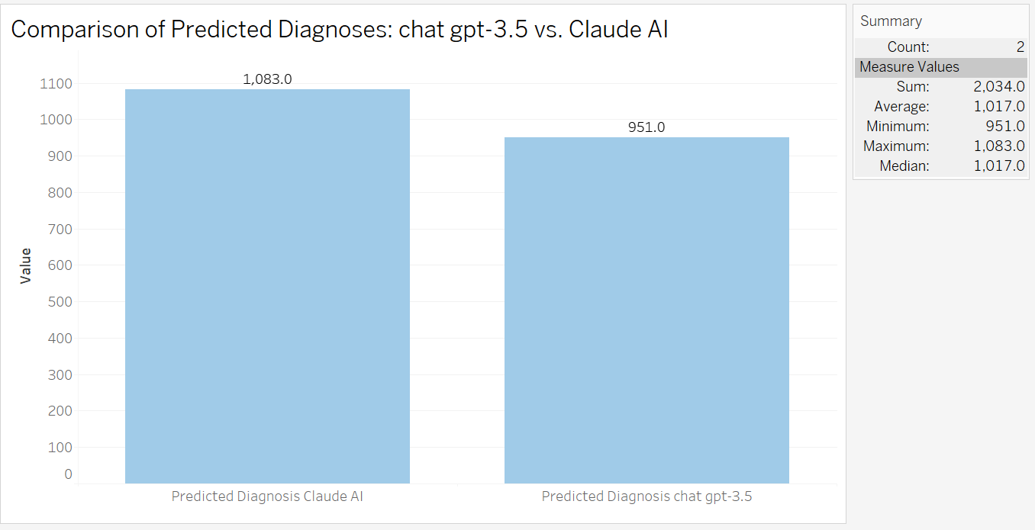
Analysis:
We explore the comparison between the actual diagnosis and the predicted diagnoses made by two different models: "Claude AI" and "chat gpt-3.5". Using a horizontal bar chart, we visually analyze the counts of each diagnosis across the three categories. The data reveals interesting insights into the accuracy of the prediction models. For instance, while some diagnoses align closely with the actual diagnosis, others show significant discrepancies. By comparing the counts of each diagnosis, we can identify patterns and discrepancies in the predictions made by the two models. Overall, this comparison sheds light on the performance of the prediction models and provides valuable insights into their effectiveness in diagnosing medical conditions. This simple and straightforward analysis offers a clear understanding of how the predicted diagnoses from "Claude AI" and "chat gpt-3.5" stack up against the actual diagnoses, highlighting areas of accuracy and areas for improvement.

Slide 18
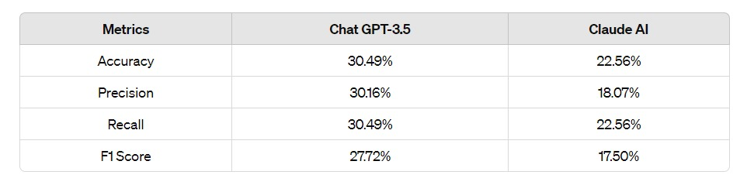
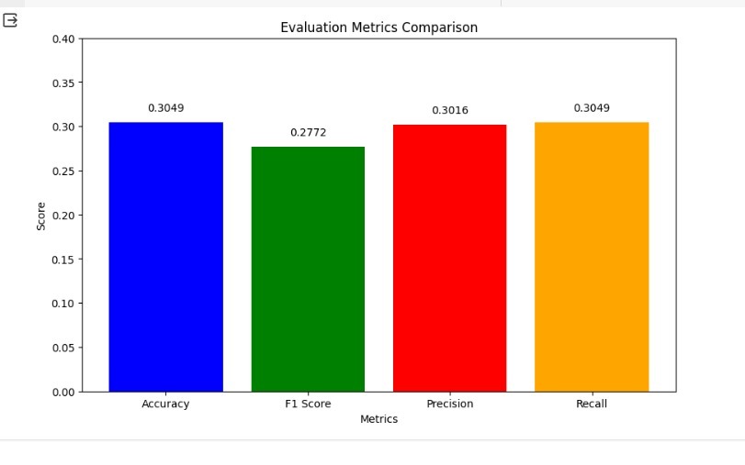
Result:
Diagnostic performance evaluation of Chat GPT-3.5 and Claude AI. This model has an accuracy of 30.49%, while the accuracy of Claude AI is 22.56%. Precision, recall, and F1 score values were not so good for both the models. Precision for Chat GPT-3.5 was a little bit ahead than Claude AI, which had 18.07% and 22.56%, respectively. The F1 score for the Chat GPT-3.5 model was higher than for Claude AI: 27.72% and 17.50%, respectively. Nevertheless, these models still require improvement, and they do not predict the outcome's diagnostic accuracy. Such results underline the necessity of continually fine-tuning and optimizing machine learning models for medical diagnosis; outstanding importance is on robust data collection, optimal model architecture, and integration of domain expertise in further research efforts. It leaves a lot of space for further research to produce more diagnostic accuracy of the AI models in health care. Such efforts will be key in bridging the gap of performance for the entire realization of AI in medical diagnosis from model refinements, improvement of data quality, and inclusion of domain expertise. Such a dive into novel techniques and methodologies helps to build improved diagnostic tools that will be both reliable and accurate to benefit not just the patients but the entire healthcare fraternity.

Slide 19
Both Chat GPT-3.5 and Claude AI are doing well but with low diagnostic performance based on the data in the current study. The Chat GPT-3.5 model has marginally outperformed the Claude AI model in terms of all evaluation indicators, such as accuracy, precision, recall, and F1 score, but still both models have been unable to reach the satisfactory level of diagnostic performance. While the overall accuracy of Chat GPT-3.5 is 30.49% and Claude AI is 22.56%, there is still a lot of room for them to move in an upper direction for better prediction.
There are several reasons for the observed performance limitation. First is in relation to the quality and representativeness of the training data. Most of the data used might not be of quality to generate proper generalization of the models to unseen cases, since some data could be inadequate or biased. Further, the complexity of the model, especially for GPT-3.5, could yield overfitting issues, since the dataset used for training was not relatively large. On the other hand, the lack of strong feature engineering may limit the model's capability to grasp relevant information in the input data and therefore influence diagnostic accuracy.
Conclusion:

Slide 20
Future Work:
Dataset Expansion: Increasing the amount of data collected or expanding an already collected dataset may help in an increase in generalization of the model.
Advanced Feature Engineering: Play around with techniques like PCA for advanced feature engineering.
Research deep learning models to understand complex relationships.
Increase Accuracy: There is a need for further fine-tuning of model architectures and hyperparameters to improve predictive accuracy.
Model evaluation: Experimenting with different metrics and evaluation techniques to get a clearer understanding of model behavior and performance.

Slide 21
Limitations:
Here are some limitations for this project on automating pancreatic cancer staging using language models:
1. Data Completeness and Quality: The completeness and quality of the report datasets used for training and testing have a significant impact on the language models' performance. It could be difficult for the models to identify precise patterns for staging if the reports are riddled with mistakes, contradictions, or incomplete data.
2. Limited Context: The whole clinical context and other information (such as laboratory results and patient history) that radiologists usually consider for staging may not be included in radiology reports. This larger context might be absent from the language models, which could affect how well they perform.
3. Uncommon or Complex Cases: The models' predictions for uncommon or complex cases of pancreatic cancer may be biased or erroneous if the datasets do not accurately reflect these types of events.
4. Interpretability and Trust: Because language models are sometimes viewed as "black boxes," it can be difficult to understand how they make decisions and win over clinical specialists' trust—a problem that is particularly problematic in crucial applications like cancer staging.

Slide 22
Contribution:
Sri Mounika Chowdary Kudapa - Introduction and Background: In this regard, Mounika has been very helpful in formulating the introduction part with necessary background information, the importance of the project, and the objectives along with methodologies. It is through this section that the theoretical and practical implications of the study come about. Furthermore, the visualization and data exploration skills of Mounika were very useful. She produced very informative plots regarding the distributions of biomarkers, which helped the team distinguish between patterns and anomalies for further analysis.
Sai Madhav Kola - Literature Review and Data Preprocessing: The summary of articles by Madhav was very well done in establishing the project context against the existing literature. It was very relevant in indicating some major studies that this work adds to, highlighting the knowledge gap, and guiding one in the right direction for this project. Madhav's specialization in data preprocessing also guaranteed quality and integrity in the dataset. In this regard, importation of data, missing values in data, and scaling techniques have been applied for a firm foundation in subsequent analysis.
Lakshmi Priyanka Komirisetty - Methodology, Machine Learning Modelling and Evaluation: It was Priyanka who described the methodologies of the project to ensure the study approach, was valid and reliable. Her methodology section was detailed, ensuring the setting of a clear blueprint to address the research objectives. Priyanka was also the major force regarding making efforts in machine learning modeling and conducting in-depth and robust performance assessments. With her knowledge, the project would have reliable and impactful results.
Lakshmi Kundeti - Data collection, cleaning plan, experiment, and data analysis plan: Fundamentally, Lakshmi engaged in the data collection process, data cleaning process, and planning for the experiment. She planned for the detailed ways in which data is to be collected and preprocessed in such a way that the quality and relevance of data under analysis is maintained. She also provided an overview of the planned experiments and analytical approaches to be conducted along with the statistical techniques. The project content was meticulously organized and systematically arranged within an Overleaf template, ensuring clarity and coherence in presentation.

Slide 23
GitHub link
https://github.com/SaiMadhavKola/ChatGPT-for-automating-pancreatic-cancer-staging-.git

Slide 24
References
1.Brown, T. B., Mann, B., Ryder, N., Subbiah, M., Kaplan, J., Dhariwal, P., ... & Agarwal, S. (2020). Language models are few-shot learners. arXiv preprint arXiv:2005.14165.
2.Chu, L. C., Ghatalia, P., Chen, J. H., Sadruddin, F., Walter, V., He, J., & Treat, J. (2021). The impact of early detection on pancreatic cancer survival: a population-based study. Cancer Research, 81(16 Supplement), 2388-2388.
3.Conneau, A., Khandelwal, K., Goyal, N., Chaudhary, V., Wenzek, G., Guzmán, F., ... & Stoyanov, V. (2020). Unsupervised cross-lingual representation learning at scale. arXiv preprint arXiv:1911.02116.
4.Cozzi, L., Comito, T., Fogliata, A., Franzese, C., Franceschini, D., Bonifacio, C., ... & Scorsetti, M. (2019). Computed tomography based radiomic signature as predictive of survival and local control after stereotactic body radiation therapy in pancreatic carcinoma. PloS one, 14(1), e0210758.

Slide 25
Thank You

